Slide 2
Your Cloud Roadmap for Building Apps with Microsoft Azure
Hamida REBAI
Architect, Microsoft MVP Developer Technologies

Slide 3

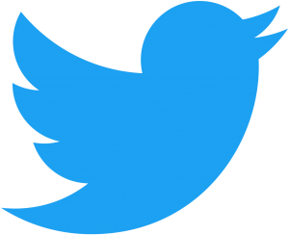


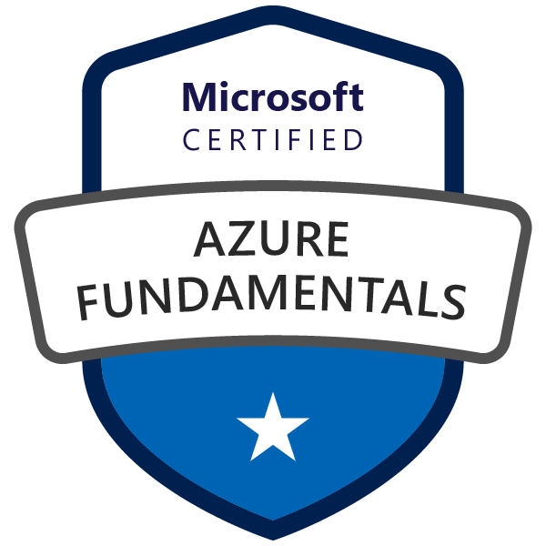
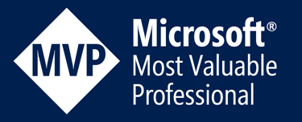
Hamida REBAI TRABELSI
MVP in Developer Technologies
Software architect
Dotnetfoundation Member
@rebaihamida
didourebai@gmail.com
https://www.linkedin.com/in/hamida-rebai-trabelsi-09b8525/

Slide 4
Agenda
Introduction
Migration analysis
Cloud Roadmap
App Modernisation with containers
Maturity Model for modernizing .NET applications
Deploying Azure Container Instance
Notes:
To accelerate a digital transformation, companies should build a strategy to move to the cloud and ensure a safe transition of your existing applications to the new approaches or start learning the new cloud patterns for a new application. This session will accompany you on a journey in the cloud computing and present cloud adoption methodologies, tools, resources, and best practices, simplifying and accelerating the move to the cloud. Before engaging in the migration, it is necessary to understand the assessment phase and adjustment needs, presentation and definition of Azure services to succeed your move to the cloud.

Slide 5
Introduction
Create the initial technical plans.
Ensure that your workloads will run as expected.
Prepare a qualitative model for estimating migration costs.
Perform the migration by limiting the impacts on the company
Notes:
Before you begin planning for a cloud migration, you need to determine how:
- Create the initial technical plans. - Ensure that your workloads will run as expected. - Prepare a qualitative model for estimating migration costs. - Perform the migration by limiting the impacts on the company so this is experimentation phase

Slide 6

Migration analysis
Notes:
This phase is the most important part in your move to the cloud because you need to understand your environment, your infrastructure, your application, the security required, the governance, to be able to decide if you are ready to go to the cloud and the cost now and after 5 years for example. Every direction in the company should contribute to the analysis.

Slide 7
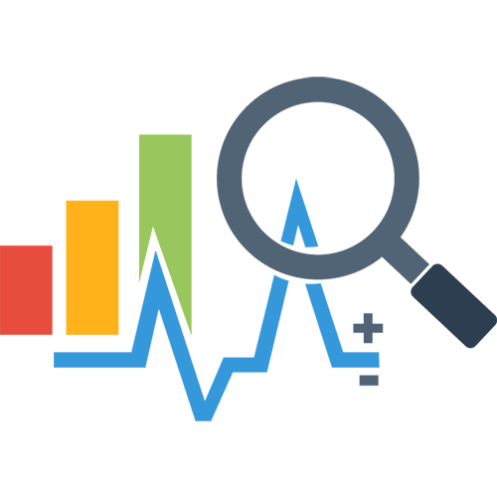
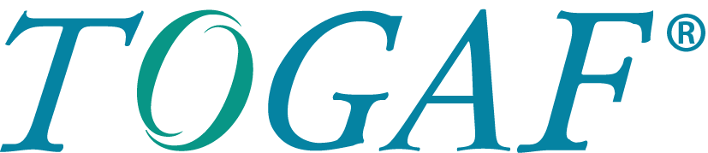
Migration analysis
The first phase of analysis may be based on a Vision of the Architecture Development Method (ADM) cycle of the Open Group Architecture Framework (TOGAF).
Notes:
The result of the first phase of the analysis is a vision architecture and to do that, some companies used TOGAF

Slide 8
TOGAF & ADM
“The TOGAF standard is a framework for Enterprise Architecture. It may be used freely by any organization wishing to develop an Enterprise Architecture for use within that organization”[1]
The TOGAF Architecture Development Method (ADM) forms the core of TOGAF.
"The Architecture Development Method (ADM) Cycle defines best practices for developing an organization's enterprise architecture.“
[1] https://pubs.opengroup.org/architecture/togaf9-doc/arch/

Slide 9
ADM
Build the technical architecture.
Plan the deployment.
Implement it.
Manage the changes.
Notes:
ADM consists of a preliminary phase followed by eight phases to:
Build the technical architecture.
Plan the deployment.
Implement it.
Manage the changes.

Slide 10

ADM phases
Vision of architecture
Business Architecture
Information systems architecture
Technological Architecture
Opportunities and solutions
Migration planning
Implementation Management
Architecture change management
Notes:
I will present the 8 phases in ADM but we will extract only 6

Slide 11

Cloud migration phases
Based on TOGAF, a cloud migration will contain six phases:
Identification of the source architecture
Identification of the target architecture
Identification of cloud solution providers.
Selection of one or more cloud providers.
Migration plan.
Migration and test.
Notes:
In any transformative change, it’s important to understand what the destination is and what the waypoints along the journey will be. There are multiple potential destinations for any application, and IT cloud deployments will be a mixture of them.

Slide 12

Cloud migration factors
The complexity of your infrastructure.
The skills of your team.
Stage of the application development cycle.
Information security levels
Notes:
The cloud migration strategy will depend on many factors:
- The complexity of your infrastructure.
- The skills of your team.
- Stage of the application development cycle.
- Information security levels

Slide 13
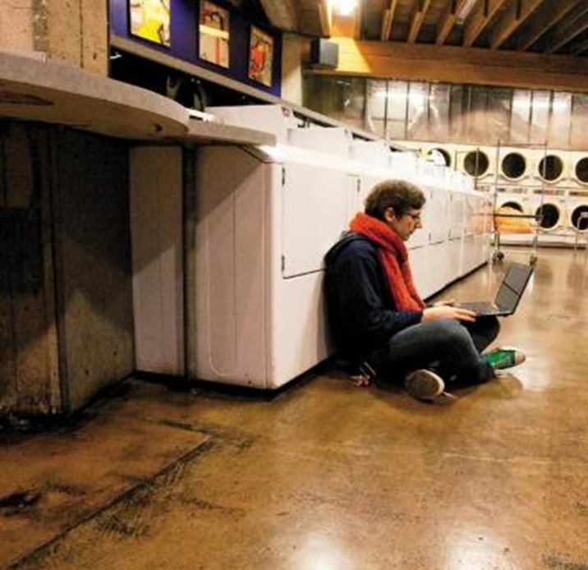
Cloud migration principles
Go Fast
Push the boundaries
Make data driven decisions
Simplify
Communicate to succeed
Notes:
Go Fast : Fail fast, learn fast Try many, use best
Push the boundaries
Push the boundaries : Design new applications and capabilities for PaaS/SaaS Refactor legacy apps for PaaS/SaaS Build your planof-record to take advantage of cloud capabilities Think “Experience”
Make data driven decisions Simplify : Manage your costs Use telemetry to gain insight into operational efficiency Understand your blockers Manage your plan-of-record
Simplify: This focuses on retiring, right-sizing, and consolidating as many services and applications as possible. Applications that are infrequently or rarely used often generate significant costs for an IT organization, with little return.
Communicate to succeed :Communicate customer and stakeholder impacts— transparency is key Share learnings and best practices

Slide 14

Cloud Roadmap Passage to the cloud
Notes:
Let’s prepare our cloud roadmap, and for that, we need to understand the different models, the types of Cloud Services

Slide 15
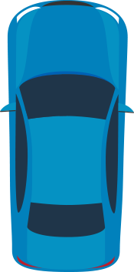
Deployment methods for cloud computing
Private
Hybrid
Public
Notes:
There are three different models of cloud deployment. A cloud deployment model defines where your data is stored and how your customers interact with it (how they access it and where the applications run). It also depends on your own infrastructure that you want or need to manage. The public cloud is the most common because you do not have any local hardware to maintain or maintain: everything runs on your vendor's hardware. Companies can use multiple public cloud providers of varying scale. Microsoft Azure is an example of a provider. In private cloud computing, the technologies are hosted in a local data center. Private clouds are convenient because they can implement a set of technologies that is consistent with the public cloud, which can be useful in scenarios where some applications or data can not be moved outside. However, private clouds do not offer the cost savings and efficiency of public clouds as they require significant capital expenditure and (potentially large) execution staff. Hybrid Cloud combines both public and private, allowing you to run your applications in the most appropriate location. For example, you can host a website in the public cloud and link it to a highly secure database hosted in your private cloud (or local datacenter).

Slide 16
Types of Cloud Services
PaaS
SaaS
IaaS
Notes:
There are three broad categories of cloud computing. It is important to understand them because you will not fail to meet them at the end of a conversation, in the documentation or as part of a training.

Slide 17
Separation of Responsibilities in Azure Model
On Premises
Infrastructure
(as a Service)
Platform
(as a Service)
Software
(as a Service)
Applications
You manage
Applications
Applications
Applications
Data
You manage
Data
Data
Data
Runtime
Runtime
Runtime
Runtime
Managed by Microsoft
You manage
Middleware
Middleware
Middleware
Managed by Microsoft
Middleware
O/S
O/S
Managed by Microsoft
O/S
O/S
Virtualization
Virtualization
Virtualization
Virtualization
Servers
Servers
Servers
Servers
Storage
Storage
Storage
Storage
Networking
Networking
Networking
Networking
Notes:
Let’s go back to the classic cloud model, to understand what we need to do,
Explain every part differently,
So we'll start with on premise. And let's imagine these are the tiers of the infrastructure that we have on premise. They're all pretty self-explanatory, they should be familiar to you. And here's the thing with all of this when you have it on premise, you manage it, it's all up to you. And of course I'm talking quite colloquially about you, if you're a developer watching this, you may have in infrastructure team who looks after it. Or alternatively perhaps your organization out sources the management of it and you have an external party take care of it within your on premise firewall. But it's still your organization who is responsible for all of these tiers in the stack. And it's a lot of work. Companies pay a lot of money to have all of this managed for them. Again, whether that be by colleagues, contractors, third-parties, it's expensive. So this is the first pillar I want to look at. The next one is IS, infrastructure as a service. And this is where we start to take away responsibility for some components of the system. You still manage a bunch of them, but there's this other set that you don't manage. And in the case of Azure, Microsoft manages these. So you can go to Azure and get a virtual machine, a logical operating system, infrastructure as a service. Microsoft is taking care of all the networking, the storage, clearly the actual servers that run in their data centers. There are still physical servers, you just never see them yourself. And then on top of that, they manage the virtualization tier. So what you end up with is a logical operating system that you can remote into and operate just like you were sitting next to the server on premise. Because you can manage that operating system, you then manage everything on top of that. That is your responsibility. Or again your company's or someone else they pay to manage those discreet tiers of the service. So this is where we then move across to PaaS. We keep taking away the things that you have to manage, so now it's only the apps and the data, and delegating responsibility back to the cloud provider. And of course this isn't just an Azure concept, the same principles apply to any other true cloud offering, but obviously we're going to be a bit Microsoft centric in this course. Now the beauty of PaaS is that the bits you actually have to worry about are very small, data and apps. We're going to look at both of those in this course. And this is about unburdening you, you don't have to do any support at the OS tier or the middleware or the runtime, Microsoft does that for you. And because they do this across such a huge array of servers and they get the economies of scale in the automation. They do that for you exceptionally cheaply so you're paying very, very small amounts of money and we'll see just how small that money is in just a moment, to manage the bits that are actually unique to you. There is one step further as well in the cloud model. And that is SaaS, software as a service. Now once we go down this SaaS path you're really not building software or managing your own data. You're using a fully managed service by the provider. So SaaS is really the extreme end of the scale. It makes a lot of sense when there's a service that you're happy for the provider just to give you entirely. So a good example of that is troyhunt. com, it runs on blogger. I do know actual coding, I don't manage the app or the data, I just configure this software as a service product that Google gives me. It works great in a case like that, but in this course we want to focus on a sample application, which in this case is a website we've been running in traditional hosting we've been running in traditional hosting and now we want to move it into Azure websites and Azure SQL databases. And of course both of those are PaaS offerings. Now before I move on, there's just one more thing that I want to touch on. And it's this, I hear this a lot, people want power, they want control and this is the traditional mindset coming through. I often hear this from people that haven't yet gone through the journey of seeing how much they can do with PaaS services on Azure. People really only say this, because there are certain things that they need to do in order to manage their environment. What I like to try and do is focus on what their objectives are. So why do you want to remote into the machine? Are you looking for CPU utilization? Well you can get that from PaaS. Do you want to see the processes that are running? That's in PaaS as well. Do you want log files? PaaS. Debugging? PaaS. There's a huge amount of stuff you can do with Azure platform is a service that people think they need a VM for. So I'm going to keep coming back and pointing those things out as we progress. Because once you move past the responsibility that goes with managing your own machine. And make no mistake, it is a responsibility and it is one that Microsoft can take on for you, things actually start to get a whole lot easier and in many ways actually

Slide 18
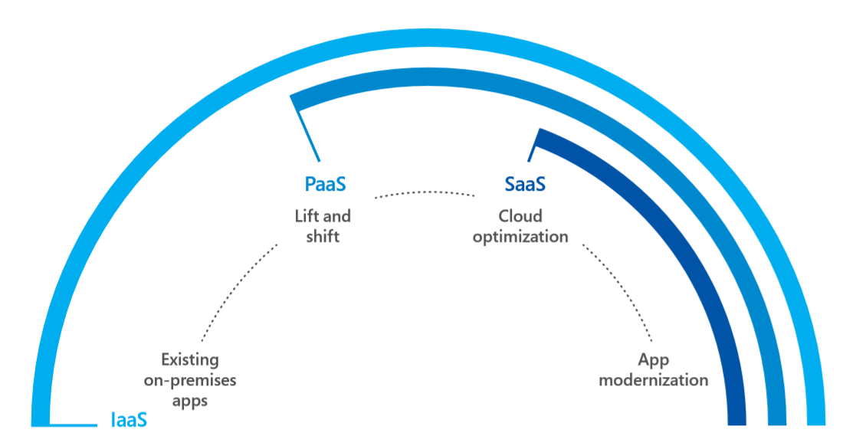
Cloud migration strategy
Migration strategies typically fall into one of four categories:

Slide 19

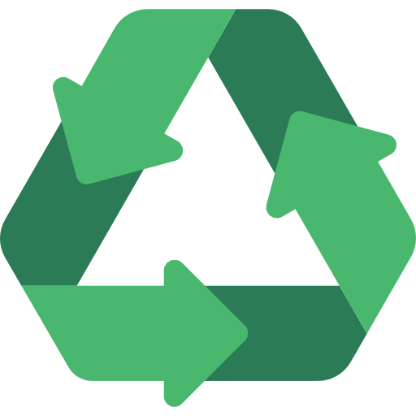
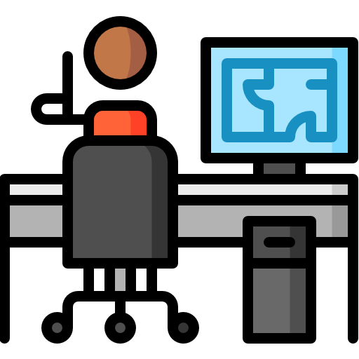

Cloud migration approaches
Applications
Data and AI
Infrastructure
Migration & Modernisation
Re-Host / Refactor / Rearchitect
Cloud – Native
Rebuild / New
SaaS
Replace
On-premises
DevOps: deliver faster and more reliably
<Re-host>
Migrate applications as they are to take advantage of the cloud without the risks or costs associated with code changes
<re-factoring>
Leverage infrastructure as a service (IaaS) and platform as a service (PaaS) without code change
<Re-architecting>
Upgrade your application to a resilient, highly scalable architecture that can be deployed independently.
<Rebuild>
Rebuild an application from scratch using native cloud technologies.

Slide 20


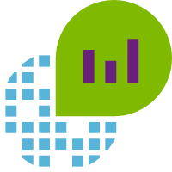
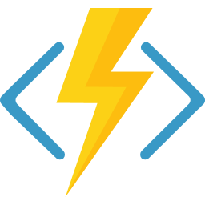
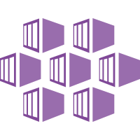
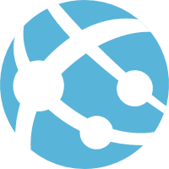
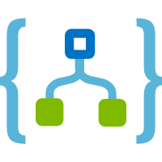
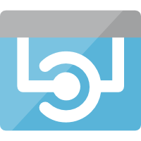
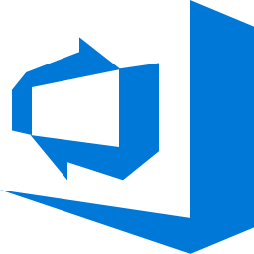
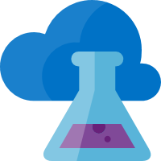
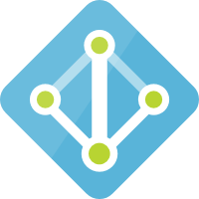
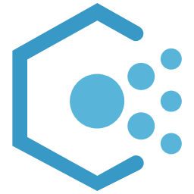
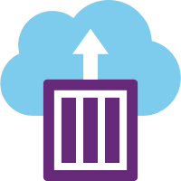
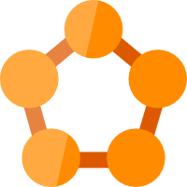
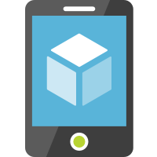


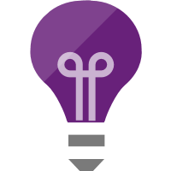
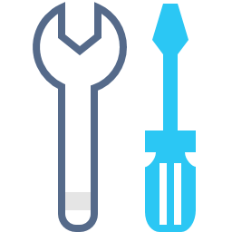
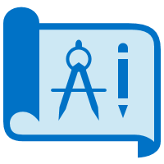
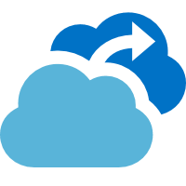
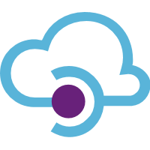
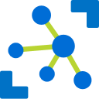
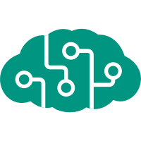
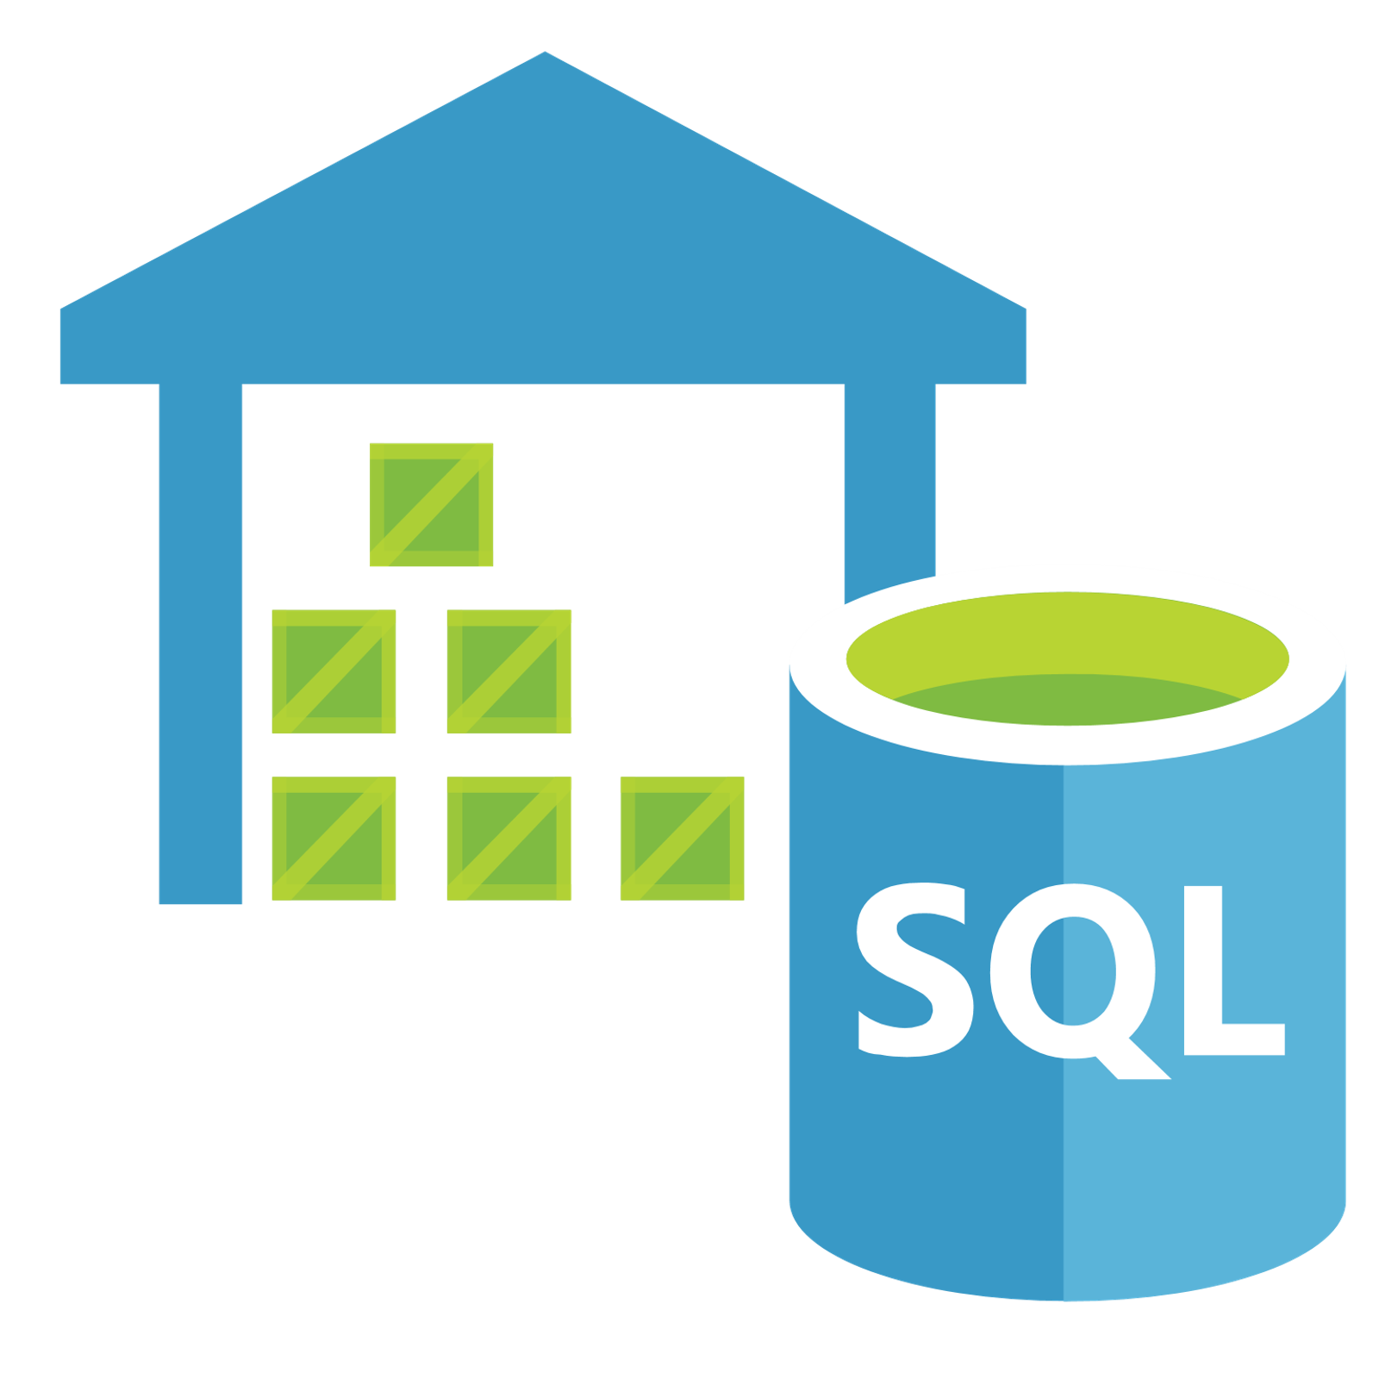
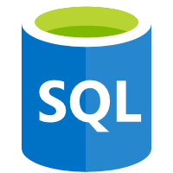
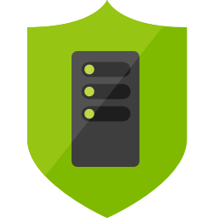
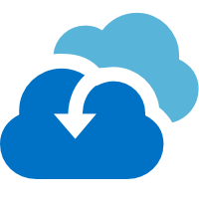

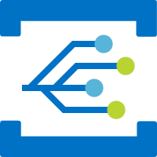
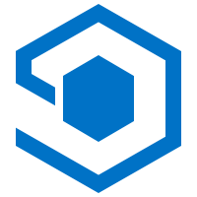
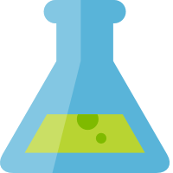
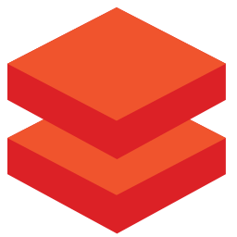
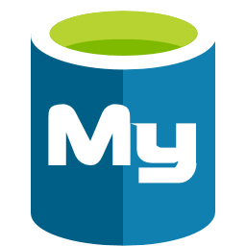


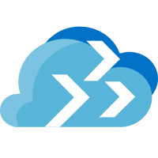

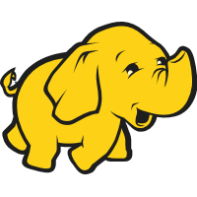
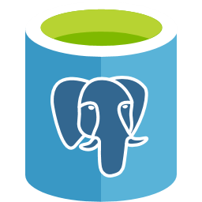
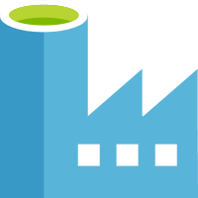

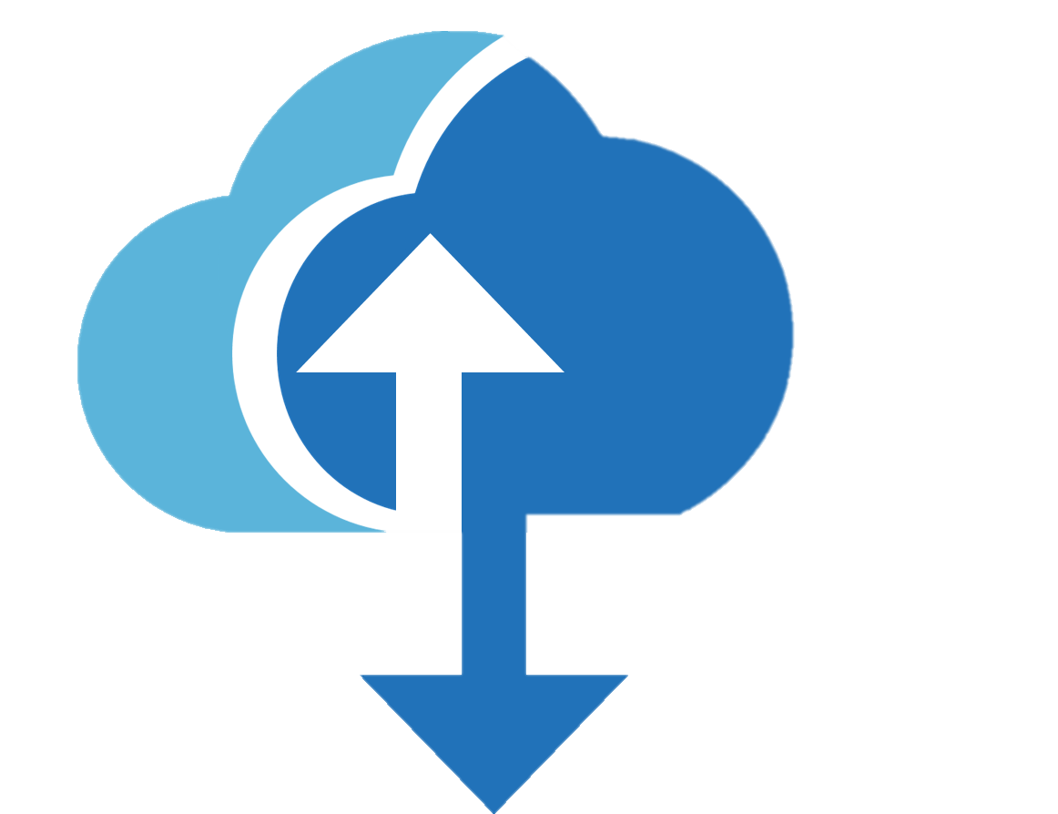
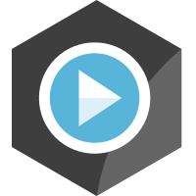

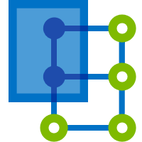

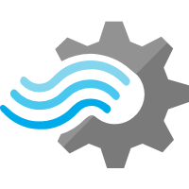
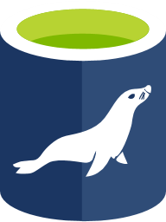
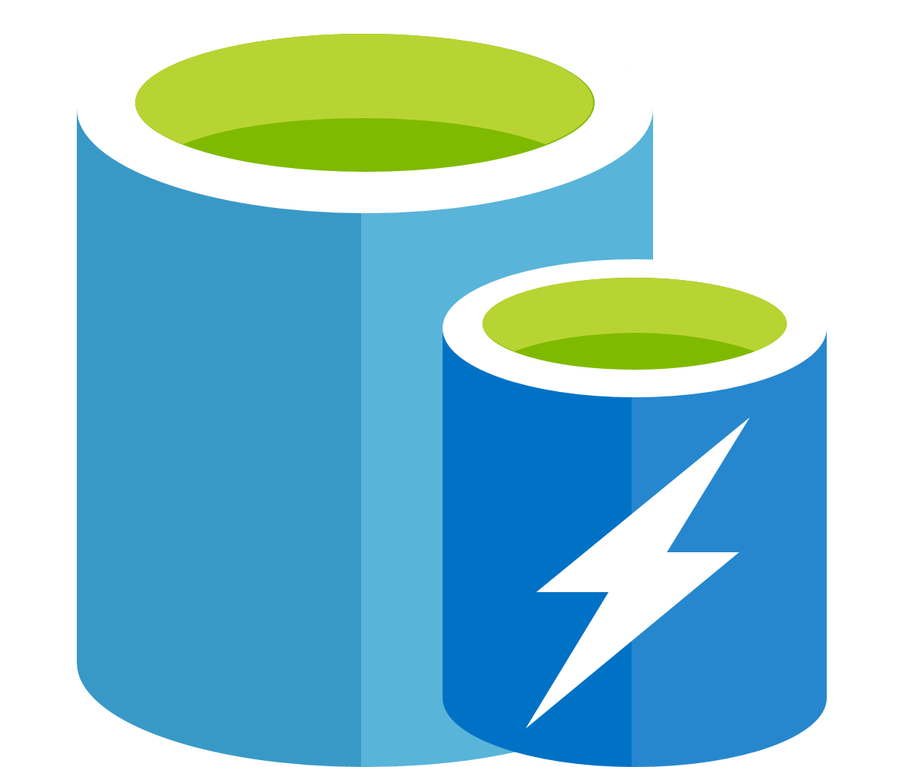


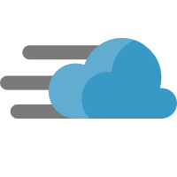


















Azure Services
Management
Platform as a Services (PaaS)
Security
Azure
Monitor
Compute/Containers
Web/Mobile
DevOps/Developer
Security
Center
Log
Analytics
Functions
Kubernetes
Service
Web Apps
Logic Apps
API Apps
Azure DevOps
Lab
Services
Azure AD
Azure
Policy
Container
Instance
Service Fabric
Mobile Apps
Notification
Hubs
SignalR
Service
Application
Insights
SDK
Azure AD for
Domain Services
Azure
Bluepirnts
Integration
IoT
AI
Analytics
Data Services
Azure AD
B2C
Azure
Backup
API
Management
Logic Apps
IoT Hub
Cognitive
Services
SQL Data
Warehouse
SQL
Database
SQL Data
Warehouse
DDoS
Protection
Site
Recovery
Service Bus
Event Grid
IoT Central
Machine
Learning Studio
Azure
Databricks
Database for
MySQL
Cosmos DB
Key Vault
Azure
Migrate
Media/CDN
Time Series
Insights
Machine
Learning Service
Apache Spark
Database for
PostgreSQL
Data Factory
Multi-Factor
Authentication
Databox
Family
Media Services
Content
Protection
Azure
Digital Twins
Bot
Services
Stream
Analytics
Database for
MariaDB
Azure Cache
for Redis
Azure ATP
Cost
Management
Video Indexer
Content Delivery
Network
IoT Edge
Azure
Search
Data Lake
Storage Gen2
Database
Migration Service
Table
Storage
Role- based
access control
Infrastructure as a Services (IaaS)
Compute
Storage
Networking
Virtual
Machine Scale Sets
Linux
Virtual
Machine
Disk Storage
Managed
Disks
Virtual
Network
VPN
Gateway
Express
Route
Load
Balancer
Azure
Firewall
Virtual
WAN
Network
Watcher
Azure Datacenter Infrastructure
Notes:
Azure is an big cloud ecosystem with a wide-variety of services.
In this session, we’re going to focus on the App modernization offered by Azure

Slide 21
Azure Services
Platform as a Services (PaaS)
Compute/Containers
Web/Mobile
DevOps/Developer
Functions
Kubernetes
Service
Web Apps
Logic Apps
API Apps
Azure DevOps
Lab
Services
Container
Instance
Service Fabric
Mobile Apps
Notification
Hubs
SignalR
Service
Application
Insights
SDK
Integration
IoT
AI
Analytics
Data Services
API
Management
Logic Apps
IoT Hub
Cognitive
Services
SQL Data
Warehouse
SQL
Database
SQL Data
Warehouse
Service Bus
Event Grid
IoT Central
Machine
Learning Studio
Azure
Databricks
Database for
MySQL
Cosmos DB
Media/CDN
Time Series
Insights
Machine
Learning Service
Apache Spark
Database for
PostgreSQL
Data Factory
Media Services
Content
Protection
Azure
Digital Twins
Bot
Services
Stream
Analytics
Database for
MariaDB
Azure Cache
for Redis
Video Indexer
Content Delivery
Network
IoT Edge
Azure
Search
Data Lake
Storage Gen2
Database
Migration Service
Table
Storage
Notes:
Azure is an enormous cloud ecosystem with a wide-variety of services.
In this session, we’re going to focus on the App modernization offered by Azure

Slide 22
The journey to the cloud
SaaS Apps
Serverless
Microservices
Rebuild
or New
Containers
Rearchitect
Refactoring
VMs
App Modernisation
On-premises infrastructures and applications
Apps
Data and AI
Infrastructure
Migration & Modernisation
Re-Host / Refactor / Rearchitect
Cloud – Native
Rebuild / New
SaaS
Replace
On-premises

Slide 23

How do containers help in app modernization?

Slide 24
































“The Application works in localhost machine!...
But not in production?”
“Use a container like Docker, dev environment is similar to production environment”
Notes:
Containers give developers the ability to create predictable environments, isolated from other applications.
Every dependency needed by the application, versions of the runtime, libraries etc., are included in the container and guaranteed to be consistent regardless of where the image is deployed
This equals productivity. Developers and Ops teams spend less cycles debugging or diagnosing environment issues and more time pushing features and enhancements to the users.

Slide 25



Containers
<On-premises>
<Re-host>
<re-factoring>
<Re-architecting>
App
Container
Container
App
App
Binaries & Libraries
Container
Container
Guest VM
OS
App
App
Existing or New Apps
Lift and shift to containers
Microservices
Notes:
Containers are not the end-state, but an in-between path to Microservices

Slide 26





Containers in Azure: a complete Set of Choices
App Service
Service Fabric
Kubernetes Service
Container Instances
Batch
Notes:
Azure provides different choices for app modernization

Slide 27







Container running on Azure
App Service
Service Fabric
Kubernetes Service
Container Instance
Ecosystem Partner
Deploy web applications or Web APIs in a PaaS environment
Modernize .NET applications in microservices using Windows Server
Orchestrate and scale the Linux or Windows Containers
Easily run containers on Azure without managing servers
Bring your partner solutions that work perfectly on Azure
Azure Container Registry
Docker Hub
Choice of developer tools and clients
Notes:
Azure natively provides several Container services and orchestrators

Slide 28






Orchestrators in Azure
Azure Product
Orchestrator / Engine | Description | Good for | Common workloads
 | Kubernetes is an open-source platform for automating deployment, scaling, and operations of application containers across clusters of hosts. AKS: You pay for VMs in cluster ACS Engine: IaaS container infrastructure |  | Microservices based on containers
 | Azure Service Fabric is a distributed systems platform that makes it easy to package, deploy, and manage scalable and reliable microservices. Mesh: PaaS/Serverless platform Cluster: You pay for VMs in cluster |  | Microservices based on containers Microservices based on plain processes Stateful services
Kubernetes
It’s an OSS ecosystem
Azure Kubernetes Service
(AKS)
More mature:
Less mature:
Service Fabric
Azure Service Fabric
(Mesh and cluster)
It’s a Microsoft ecosystem
and OSS
More mature:
Less mature:

Slide 29










From container to Orchestrator
Development and
Deployment technologies
Cloud infrastructure and
Some Orchestrators
Azure Container Service
Mesos DC/OS
Kubernetes
Docker Swarm
.NET Framework
.NET Core
Orchestrators
Dev environment
Azure Service Fabric
BLOB Storage
Service Bus
SQL Database
Docker Containers
Cloud
Infrastructure
Production environment
Deployment
environment
Cosmos DB
Redis Cache
Key Vault
Architecture/Design/Development
Infrastructure Decisions
Production-Ready Microservices

Slide 30
Windows Containers are a strategic way to modernize your existing .NET Framework applications

Slide 31

Maturity Model for modernizing .NET applications

Slide 32








Migration - Lift & Shift - IaaS
Lift & Shift
.NET Web apps (Cloud)
Infrastructure
(as a Service)
On Premises
Traditional Apps
.NET Web application
Applications
Applications
You manage
Data
Data
Runtime
Runtime
On-Premises
IaaS Cloud
Middleware
You manage
Middleware
Relational Database
O/S
Managed by Microsoft
O/S
Virtualization
Virtualization
Servers
Servers
Storage
Storage
Monolithic Architecture
Monolithic Architecture
Networking
Networking
No re-architect, no code changes
Notes:
Traditional Apps Using:
Servers or VMs on-premises
SQL Server, Oracle, MySQL, etc.
Lift & Shift : Virtual Machines (VM)
Azure SQL DB Managed Instance

Slide 33



Cloud DevOps-Ready - PaaS
On Premises
Traditional Apps
.NET Web application
Lift & Shift
.NET Web apps (Cloud)
Platform
(as a Service)
You manage
Applications
Applications
PaaS Cloud
Data
Data
Runtime
Runtime
On-Premises
Middleware
Managed by Microsoft
You manage
Middleware
O/S
Relational Database
O/S
Virtualization
Virtualization
Servers
Servers
Storage
Storage
Networking
Monolithic Architecture
Networking
No re-architect, no code changes

Slide 34
Cloud DevOps ready – Full PaaS
On Premises
Traditional Apps
.NET Web application
Cloud Optimized
.NET Web apps (Cloud)
Platform
(as a Service)
You manage
Applications
Applications
Full PaaS Cloud
Data
Data
Runtime
Runtime
On-Premises
Middleware
Managed by Microsoft
You manage
Middleware
O/S
Relational Database
O/S
Virtualization
Virtualization
Servers
Servers
Storage
Storage
Networking
Monolithic Architecture
Networking
Architected for the Cloud – New Code to adapt
Notes:
Extend your apps with new services based upon Server less computing, Microservices architecture and PaaS services (AppService) to fully exploit the advantages of the cloud.

Slide 35











Azure Database Migration Service
On-Premises
Microsoft Azure
Assessment
SSMA & DMA
Azure Database Migration Service
SGBDR Or NoSQL
Azure Database

Slide 36



.NET migration alternative and choice
Azure App Service
Azure Virtual Machines
.NET Application
MVC App
Web Forms App
NO
Dependencies
Web API service
Windows containers on Azure VMs
YES
Windows Containers on Azure Container
Services (ACS)
SignalR service
YES
Migration Process?
NO
Windows Containers on Azure Service
Fabric
Web Pages App
WCF service
Notes:
Dependencies can be documents, file system, COM-objects,…
While containers support a quick migration path, since no code needs to be changed, it has a more complex learning curve than migration to Azure VMs

Slide 37
Demo
Deploying Azure Container Instance

Slide 38


Prerequisites Environment
Windows 10 is required for Docker installation.
Visual Studio 2019 or 2017 has built-in support for Docker
.NET Core SDK
Docker for Windows
Docker Tools

Slide 39



Deploy a Modern Applications for Azure Kubernetes Service (AKS)
Create and Push images
with docker desktop
Commit Azure Repos
and build Docker images
Push Docker images to
Azure container registry
or Docker Hub
Deploy to AKS

Slide 40
Create and Push images with docker desktop
Demo 1

Slide 41
Push Docker images as Azure Web Apps
Demo 2

Slide 42
Push Docker images to Azure container registry and Docker Hub
Demo 3

Slide 43
Deploy to AKS in Azure DevOps
Demo 4

Slide 44


Hamida REBAI TRABELSI
MVP in Developer Technologies
. Net Consultant
Twitter: @rebaihamida
Email: didourebai@gmail.com
Github:

